Slide 1



BUSINESS DATA MANAGEMENT CAPSTONE PROJECT
Analysing the Financial Performance of
Top Shelf: A Stationery Retail Business
Presented by
Kushagra
Roll no: 24DS1000083
Indian Institute of Technology, Madras

Slide 2

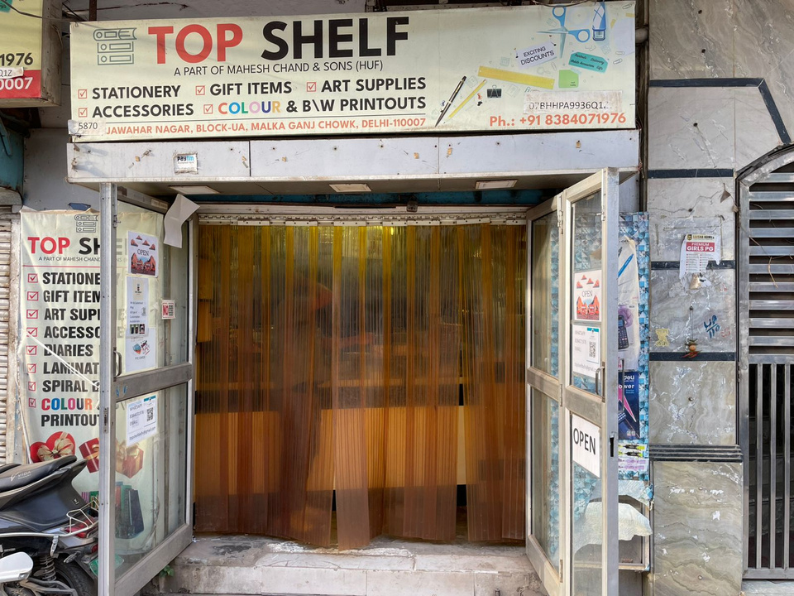
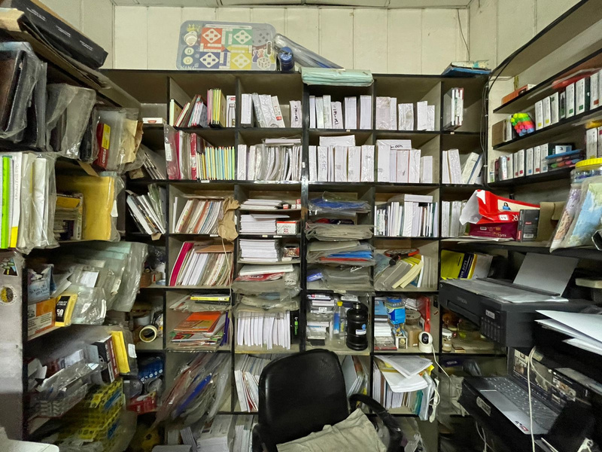
ORGANIZATION BACKGROUND
Top Shelf, established in 2013, is a leading stationery store located at Malka Ganj Chowk, Kamla Nagar, serving the student hub of Delhi University’s North Campus.
Established: 2013 by Mr. Mukul Agarwal
Key Location: Malka Ganj Chowk, Kamla Nagar (Delhi University North Campus)
Business Type: Stationery Retail Store
Product Range: Academic & office stationery, essential supplies
Team Strength: 2 staff members

Slide 3
PROBLEM STATEMENT
1. Managing Seasonal Demand Fluctuations: Demand peaks during semester starts and exams, while dropping sharply during breaks, leading to inconsistent sales and inventory issues.
2. Optimizing Inventory Through Sales Trend Analysis: Poor visibility into fast- and slow-moving items results in overstocking, stockouts, and inefficient capital use.
3. Refining Product Assortment for Profitability: Unoptimized shelf space and an ineffective product mix limit profit margins and prevent capital from being used on higher-return products.

Slide 4
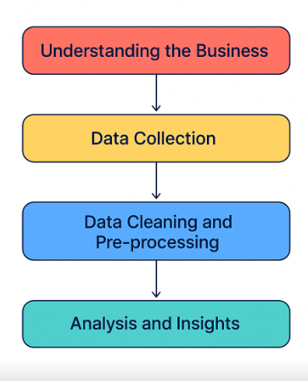
PROCESS OF DATA CLEANING AND ANALYSIS
❖ After receiving the Authorization Letter from IIT Madras, we conducted in-person meetings with the shop owner to understand the business and its challenges.
❖ Post proposal approval, sales and inventory records (originally) maintained in handwritten format) were manually transcribed into Excel for structured analysis.
❖ The dataset was then imported into Google Colab, where graphs were plotted and preprocessing steps like cleaning and formatting were performed.
❖ Key analyses included Inventory Performance, Category-wise , Seasonal Demand Trends, and Forecasting to generate actionable insights.

Slide 5
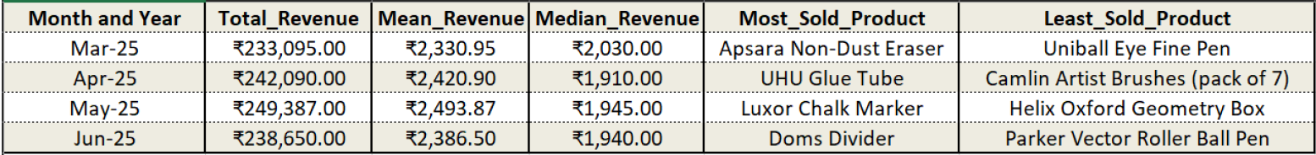
DESCRIPTIVE STATISTICS
Revenue & Sales Insights (Mar 2025 - Jun 2025)
❖ Revenue Trends:
Highest Total Revenue: May 2025 (₹249,387)
Lowest Total Revenue: Mar 2025 (₹233,095)
Mean Revenue: Highest in May 2025 (₹2,493.87) and Lowest in Mar 2025 (₹2,330.95)
Median Revenue: Highest in May 2025 (₹1,945.00) and Lowest in Apr 2025 (₹1,910.00)
❖ Sales Performance:
Most Sold Products: Apsara Non-Dust Eraser (Mar), UHU Glue Tube (Apr), Luxor Chalk Marker (May), Doms
Divider (Jun) .
Least Sold Products: Uniball Eye Fine Pen (Mar), Camlin Artist Brushes (Apr), Helix Oxford Geometry Box
(May), Parker Vector Roller Ball Pen (Jun).

Slide 6
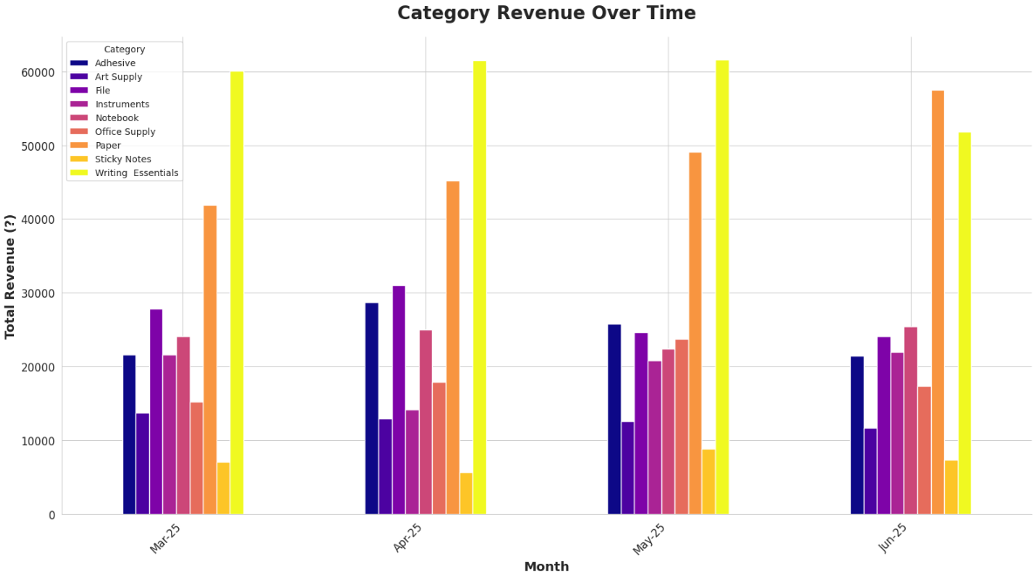
MANAGING SEASONAL DEMAND FLUCTUATIONS
❖ Revenue trends across categories show significant month-to-month variations, especially in Paper and Writing Essentials, which dominate overall sales.
❖ Some categories like Sticky Notes and Adhesives remain consistently low, while others like Files and Office Supply show moderate but irregular growth.
❖ These fluctuations make it difficult to forecast inventory requirements, leading to risks of stockouts in peak demand and overstocking in lean periods.
❖ Effective demand forecasting and seasonal planning are needed to balance supply with shifting customer needs.

Slide 7
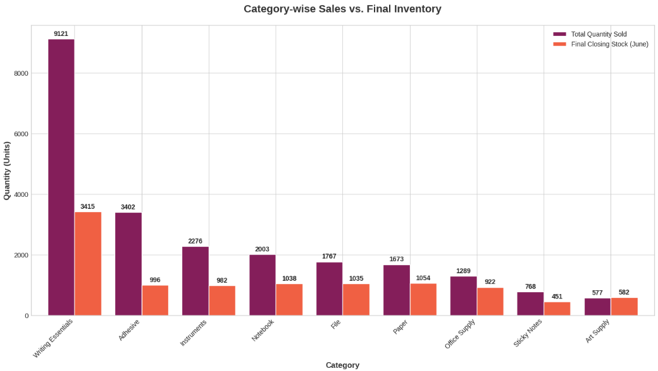
INVENTORY MANAGEMENT ANALYSIS
❖ Category Performance:
Writing Essentials recorded the highest sales (9,121 units), followed by Adhesives (3,402 units).
Sticky Notes (768 units) and Art Supply (577 units) showed the lowest sales volumes.
❖ Final Stock (June):
Writing Essentials still maintained the largest closing stock (3,415 units).
Art Supply (582 units) and Sticky Notes (451 units) had the lowest remaining inventory.
❖ Insights:
High demand in Writing Essentials indicates a core revenue driver, requiring continuous replenishment.
Categories like Art Supply and Sticky Notes show slower movement, indicating possible overstocking or low demand.

Slide 8
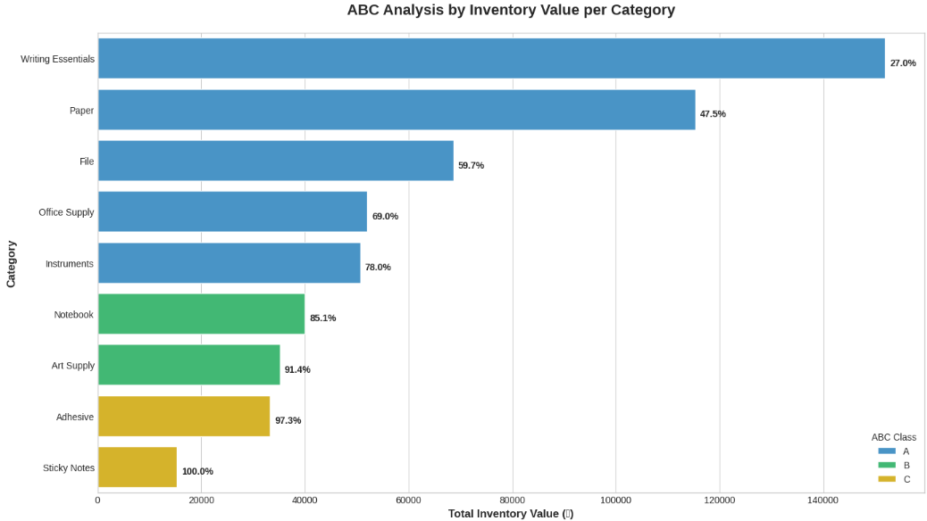
ABC SEGMENTATION OF PRODUCT CATEGORIES
❖ Category Classification (ABC Analysis):
Class A (High Value, Tight Control): Writing Essentials (27%), Paper (47.5%), File (59.7%)
Class B (Moderate Value, Periodic Control): Office Supply (69%), Instruments (78%), Notebook (85.1%), Art Supply (91.4%)
Class C (Low Value, Loose Control): Adhesive (97.3%), Sticky Notes (100%)
❖ Insights:
Class A categories contribute the major share of inventory value and need frequent monitoring & replenishment.
Class B categories represent moderate inventory importance, requiring balanced control.
Class C categories have minimal impact on total value and can be managed with relaxed controls.

Slide 9
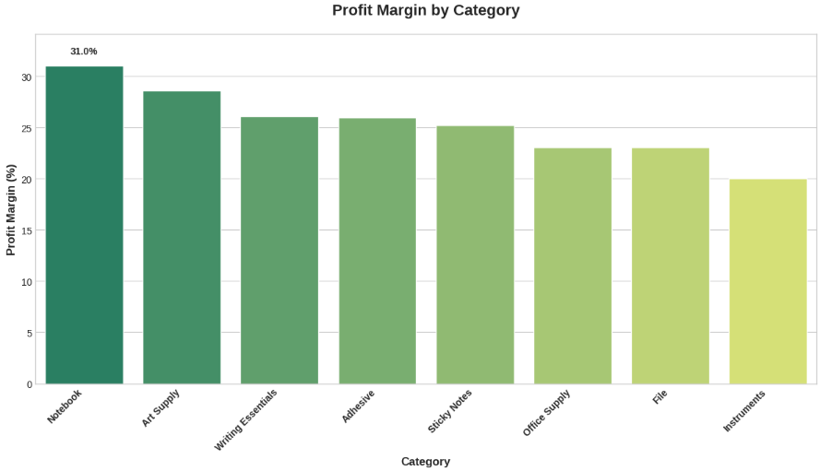
REFINING PRODUCT ASSORTMENT FOR PROFITABILITY
❖ Profitability varies significantly across categories – Notebooks deliver the highest margin (~31%), while Instruments have the lowest (~20%).
❖ Categories like Art Supply and Writing Essentials also provide relatively strong margins, but they don’t always align with top revenue contributors.
❖ On the other hand, high-revenue categories such as Paper are missing from the top profit margin brackets, indicating a mismatch between sales volume and profitability.
❖ This imbalance highlights the need to refine product assortment, focusing on promoting and expanding higher-margin categories while optimizing low-margin, high-volume items.

Slide 10
RECOMMENDATIONS
❖ Dynamic Multi-Peak Strategy : Replace uniform planning with category-specific demand cycles, ensuring stock and promotions align with peak periods of Writing Essentials, Paper, and Office Supply.
❖ Data-Driven Inventory Policy : Tailor reorder points and safety stock to ABC classification and sales velocity, freeing up capital locked in slow movers like Paper and Instruments.
❖ Capital Efficiency : Reduce overstocking through clearance and lean procurement in low-turnover categories; shift resources to fast-moving, high-potential items.
❖ Profit-Centric Product Mix : Rebalance assortment by sustaining paper as a traffic driver while promoting higher-margin categories such as Notebooks and Art Supply.
❖ Assortment Optimization : Delist or downsize underperforming SKUs in File and Instruments to reallocate shelf space to profitable alternatives.
❖ Targeted Marketing & Bundling : Increase transaction value via bundles and upselling of premium items, while enhancing visibility of high-margin categories.

Slide 11
THANK YOU

